Slide 1
Helping Struggling Middleschool Students with an iPad
Brenda Boks
Oct. 2014
bboks@beaconchristian.org
www.resourcefulresourceteacher.com

Slide 2


A bit about me
A grade two teacher
A resource teacher
A substitute in every grade
Passionate about Jesus, my husband, my kids, “my kids”, and my dog.

Slide 3
Disclaimer
iPad for Mother’s Day a few years ago, 20 in our school, 4 in the resource room, 3 minis for teachers and now a class set of Chrome books
No expert but constantly needing to mess around and figure things out

Slide 4
Survey of the crowd
School owns an iPad, more than one iPad
            OR
You bring your own personal iPad to school
You have little experience with an iPad
You are just getting started
            OR
You’ve been messing around with an iPad or Apple product quite a bit

Slide 5
Goals for today
Get you thinking about the different ways in which technology can help differentiate your instruction
Get you experiencing some examples of apps I think fall into some very useful categories
Experience how an app could be used specifically to help a struggling student

Slide 6

Is it fair?

Slide 7
UDL
Universal Design for learning
“many accommodations are useful for
some and good for all”
Maich and Sider, 2014
What Works? Research Into Practice, Feb. 2014

Slide 8

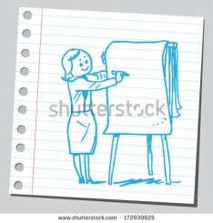
Common classroom uses:
Review games
Motivation
Movies (iMovie) and Music (GarageBand)
HOW IS IT USED IN YOUR SCHOOL?
HELPFUL APPS (write on chart paper)

Slide 9
Classroom Management
Its a tool. When a tool is not useful, it gets put away.
Turn upside-down. You need a case that will ensure no scratching.
Penalty. Two minutes.
Crust of the bread vs middle of the bread. Save the best for last.

Slide 10
Today
Help with Careless Errors in Math
Speech to Text
Text to Speech
Word Predicting and Word Processing
Studying
Alternative Curriculum (such as speech, language, fine motor control, memory boosting, ELL, etc.)

Slide 11

Things to keep in mind
Cost
Covers
Headphones Multi Headphone Splitter
Clear expectations
Try it yourself first. Be sure to make “mistakes” (perhaps make a tip sheet).
How will you print or share

Slide 12
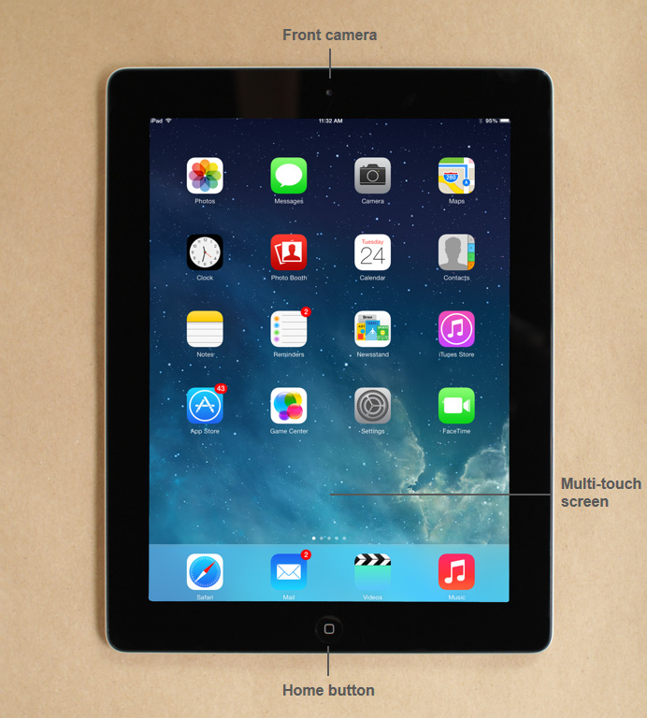
Hand out ipads
(one for every two people)

Slide 13
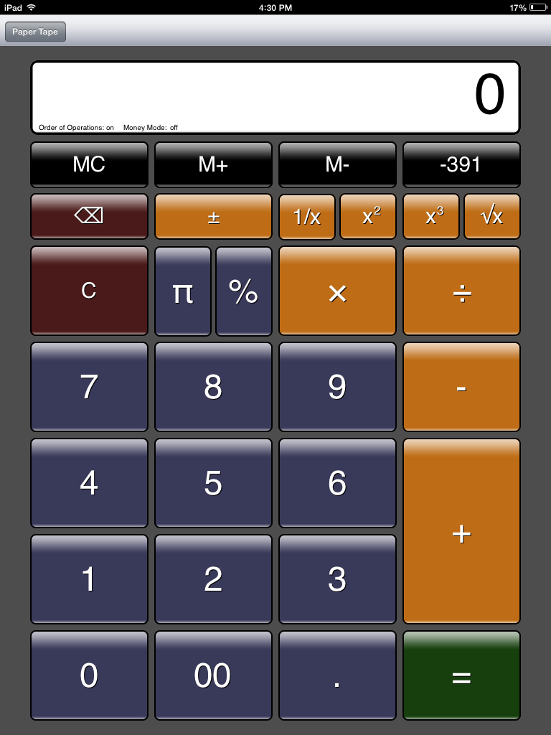
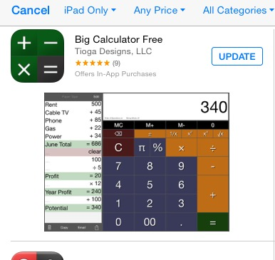

Mrs. Boks folder
Math
Big Calc Free (talking mode $1.99)
Try it out!
Uses in the classroom?

Slide 14
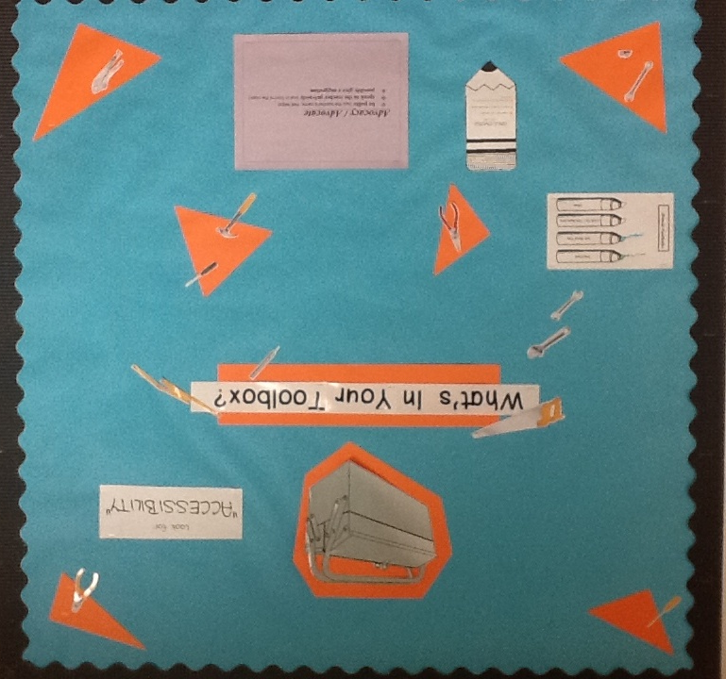
Text to speech
ACCESSIBILITY

Slide 15
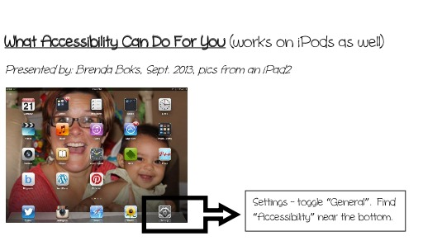
Settings – General - Accessibility

Slide 16
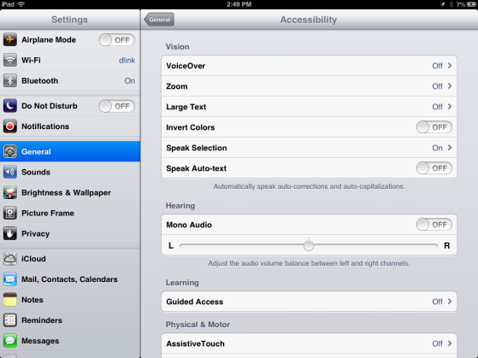
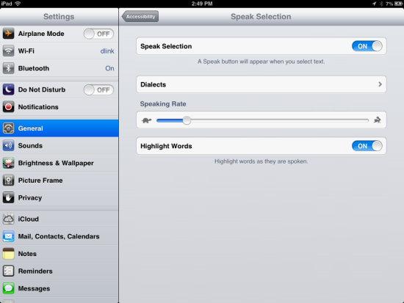
Speak Selection (not “VoiceOver”)– Speaking Rate

Slide 17
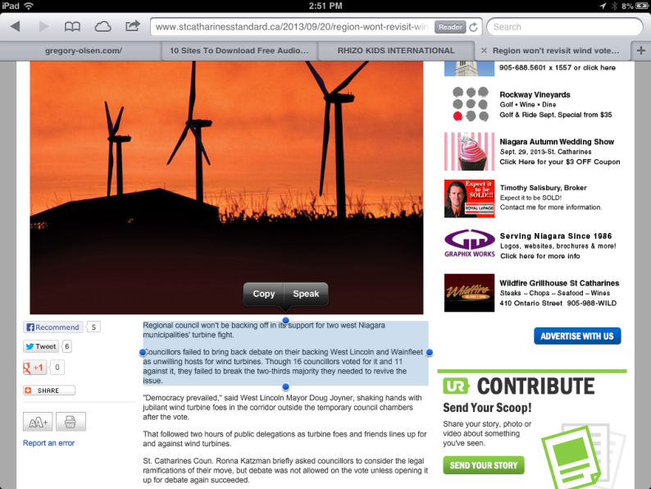
Open a link in safari or
any document that can
be highlighted
Highlight text by holding a finger on it. You may have to adjust the amount highlighted. “Speak” should now be one of the choices.

Slide 18


Try it out!
Go to iBooks on your iPad.
Open “What Works, Research Into Practice” from the Ministry of Education.
Highlight text and select “speak”.
Done early?
Try “Safari” and your local newspaper.

Slide 19
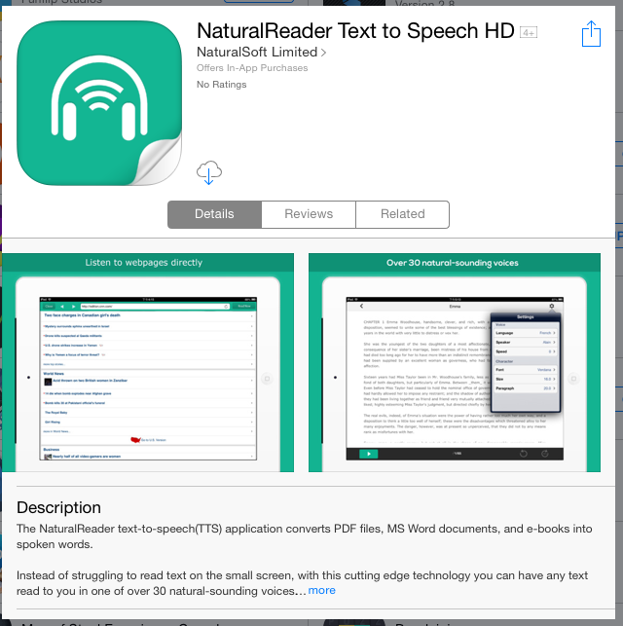
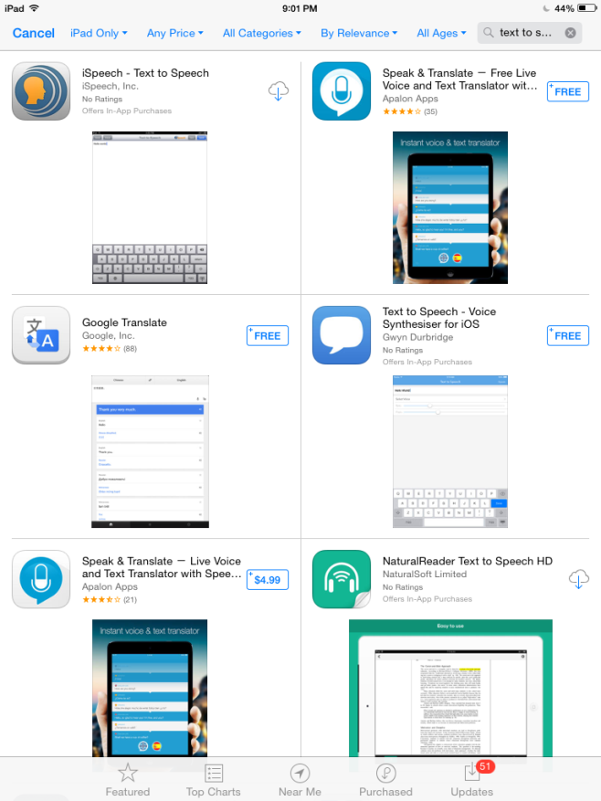
More Text to Speech Options
Uses in the classroom?

Slide 20

Word predictor
iWordQ
Predicts words as a student types.
Compare it to http://onlinestore.strategictransitions.com/product_p/wq3-en-01.htm

Slide 21
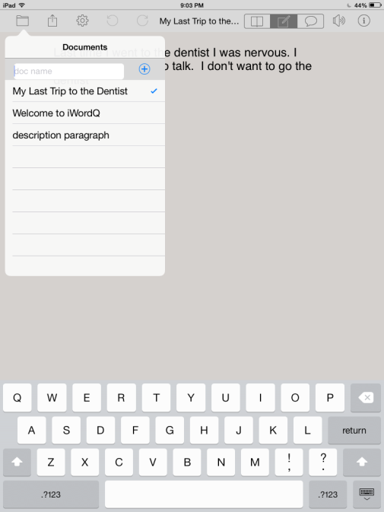

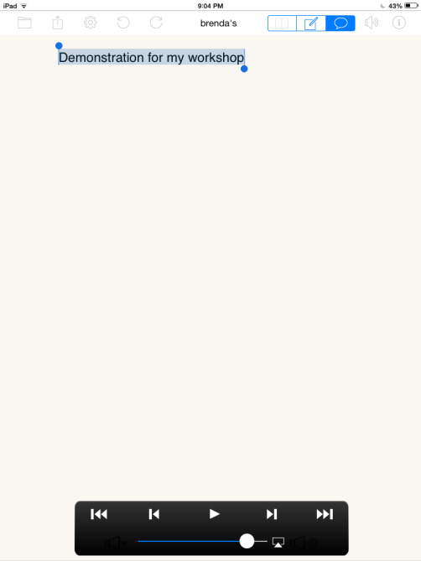
To start a file or find a file
To start typing
To have the passage read
Try it out!

Slide 22
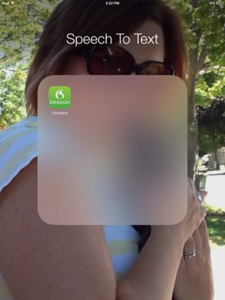
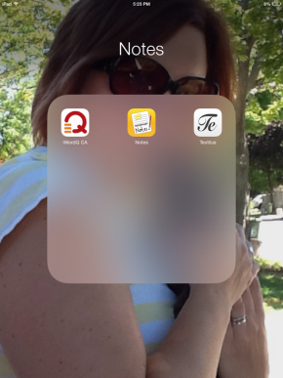
Speech To Text
Dragon Naturally Speaking
PaperPort Note

Slide 23

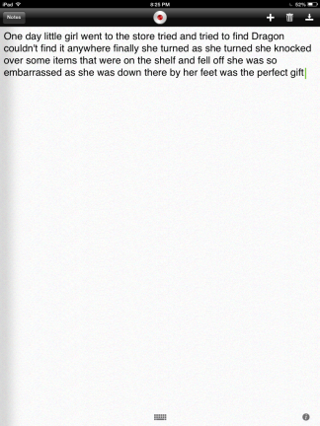
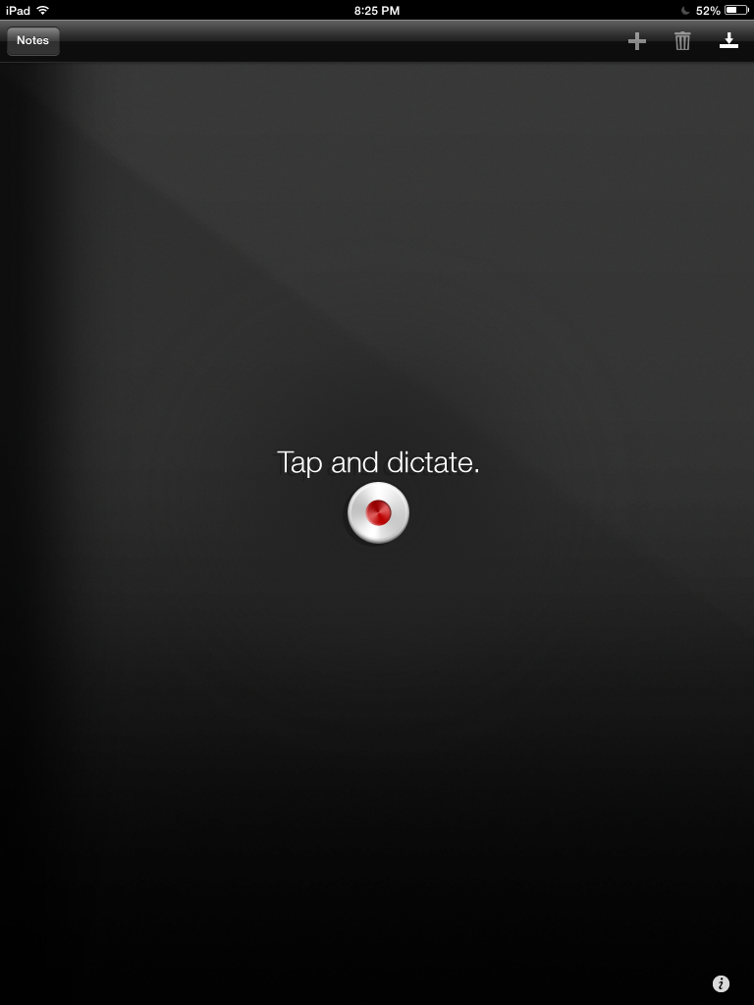
Find Files
Add a file
Export a file
Grab the keypad
Try it out!
Uses in the classroom?
Dictate a story about a day in the life of a teacher.

Slide 24

Try it out!
https://www.youtube.com/watch?v=6Yu1Fg4xu9E (1 min)
Or
https://www.youtube.com/watch?v=axgo_0GoA98 (4 min)
Try the PaperPort Note App to dictate a story about going to the dentist.
If you need a challenge, add a picture to the PaperPort Note document.
Uses in the classroom?

Slide 25

Studying
Shadow Puppet
Pyramid Facts
French Poem to Learn

Slide 26
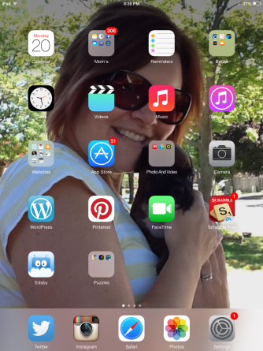
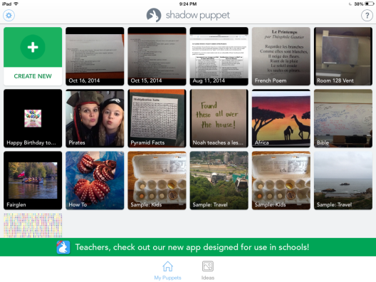
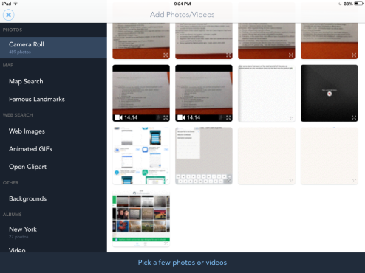
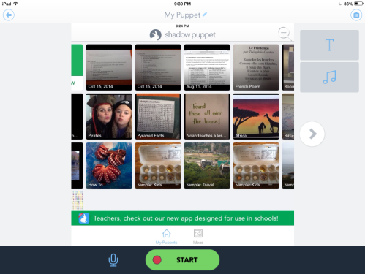
Shadow Puppet
Take photos of the review sheet
Open the app and add the photos
Record your voice with each photo
Watch your movie
Notice how you would email this to a student. (It will run on his PC)
Try it out!
Uses in the classroom?

Slide 27




Handouts Read to Students
TRY IT Out
QR Code – Quick Response
Record your voice on app like VoiceRecord Pro and save as an MP3 and send to dropbox: jbjboks@netscape.net, passwd: enteringthestory
Open dropbox.com in Safari and find your file. Make sure to move it to from the app file to “public”. Click “Copy the Public Link”
Go to a free QR generator such as QR Code Generator app
(can be easier to generate on the PC at a free QR generator site)
4. Insert (paste) link to your MP3 file (Add, name, copy link).
Create a QR code. Save the QR code – it is now in photos.
Print QR code for student and attach to handout (be sure that when you print it, all the corners are complete.)
Student scans it with Qrafter app (or other) and chooses “open URL in safari”
Uses in the classroom?

Slide 28
Alternative Curriculum
Alternative Curriculum | Apps to Try
ELL (English Language Learners) | Over, $1.99
Speech – articulation | Phonics Studio (GrasshopperApps), free
Language – pragmatics | Pragmatics (Super Duper Publications) $3.99
Fine Motor Skills | Dexteria,$3.99; LetterReflex, $3.99 (reversals)
Memory Boosting | Box Trot, free
Executive Functioning | Use calendar and reminders, Time Timer $4.99
Relaxing and calming | Relax Melodies HD, free
Try it out!

Slide 29
Helpful websites:
www.resourcefulresourceteacher.com
http://www.edu.gov.on.ca/eng/literacynumeracy/inspire/research/WW_TechnologyTools.pdf
UDL from CAST (Center for Applied Special Technology)
AIM (National Center on Accessible Instructional Materials)
http://www.udlcenter.org/aboutudl/udltechnology

Slide 30
Thank you!
Review:
Math accuracy
Text to Speech
Speech to Text
Studying or show what you know
Read aloud or motivation
Organizing (executive skills)
Alternative Curriculum
Questions or Discussion

